Slide 1
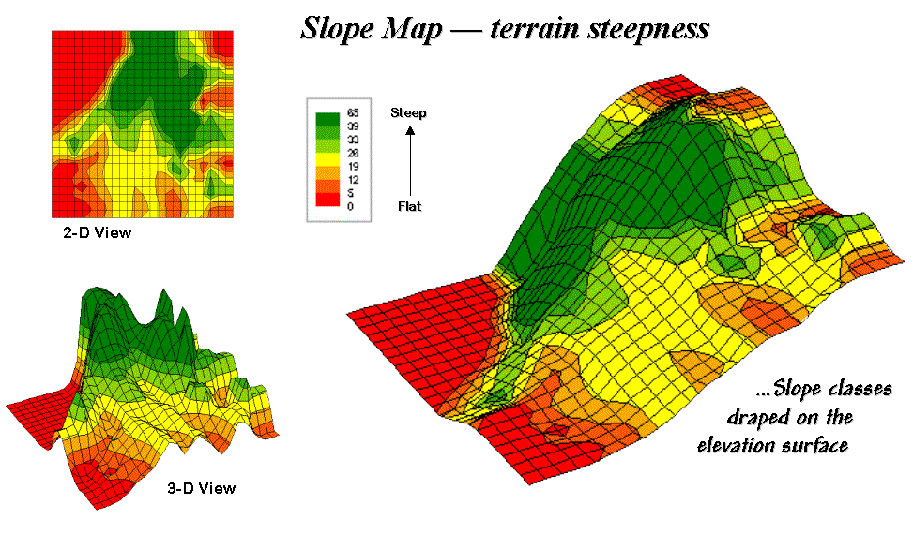

Rasters IV: Terrain Modeling
GIS in the Sciences
ERTH 4750
Steve Signell, Instructor
Friday, February 16, 2018
Notes:
Some content taken from https://www.colorado.edu/geography/class_homepages/geog_4203_s08/class6_TerrainAnSlopeAspect.pdf

Slide 2
Terrain Modeling
Why Terrain Matters:
Resource Availability
Climate & Weather
Natural Hazards
Flooding
Avalanche
Transportation
Hydrology
Building & Construction

Slide 3
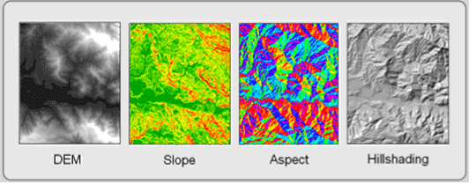
Terrain Modeling
Some DEM-derived datasets:
Slope
Aspect
Hillshade
Curvature
Visibility
Profiles
Contours
Hydrologic flow modeling.

Slide 4
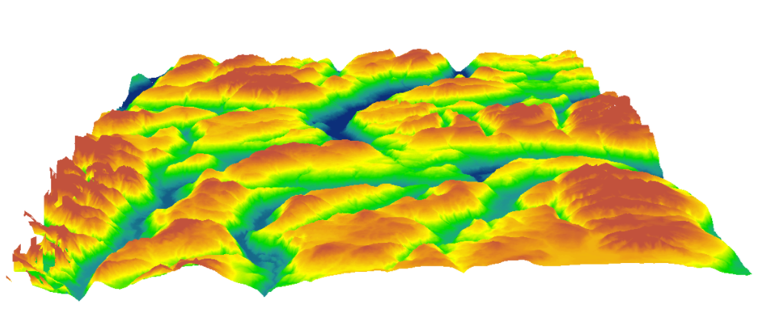
Terrain Modeling
All derived from Digital Elevation Models

Slide 5
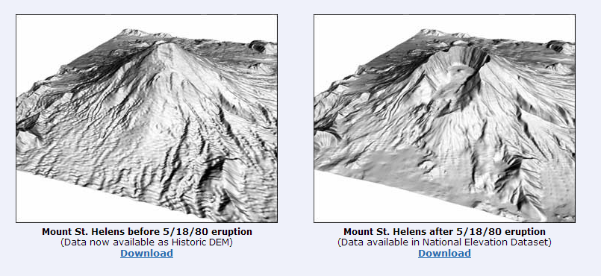
National Elevation Dataset
Updated regularly to reflect better data, changes in the landscape

Slide 6
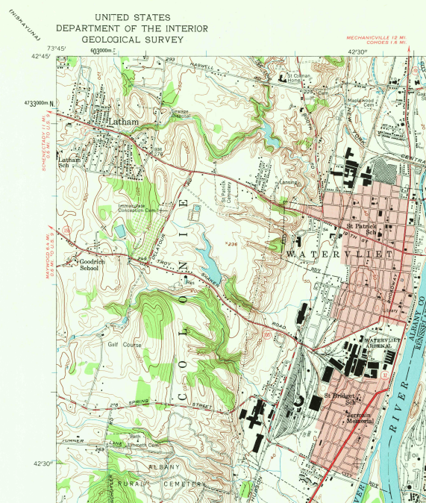
Digital Elevation Models
National Elevation Dataset (NED)
Originally derived from USGS contour maps
Resolution: 10-30m
Not empirical, quality varied by surveyor/map

Slide 7
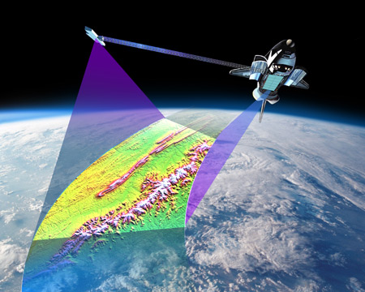
Shuttle Radar Terrain Model (SRTM)
Attempt to make empirically-derived DEMs
Satellite-derived radar data
Resolution: 30m
Lots of noise, artifacts in the data
Holes in high relief areas.

Slide 8
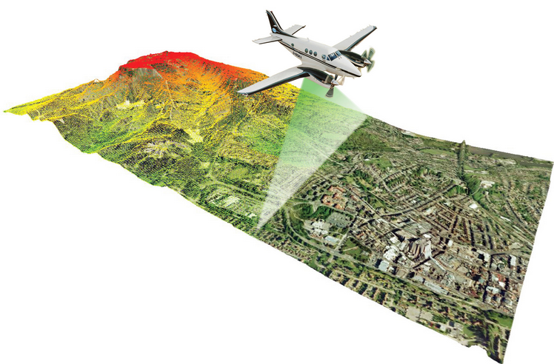
LiDAR
Now, USGS is slowly converting to LiDAR
(Li→light, DAR→radar)
Flown in planes, not satellites
Sub-meter resolution: cm
Multiple returns
Vegetation
Understory
Ground
Water
Lakebed
Etc.
So good, can replace surveying in some cases

Slide 9
National Elevation Dataset
Terrain Modeling

Slide 10
Slope Modeling
What is slope?
The incline, or steepness, of a surface (‘rise over run’)
Usually expressed in percent or degrees.
Can be thought of as a plane at a tangent to a point on a surface, e.g. a raster cell centroid.
Slope has 2 components:
Gradient: maximum rate of change of the elevation of the plane (the angle that the plane makes with a horizontal surface). This is usually just called ‘slope’
Aspect: the direction of the plane with respect an arbitrary direction, usually north.
Direction water will flow
Amount of sunlight
Viewshed (what is visible from a point)

Slide 11
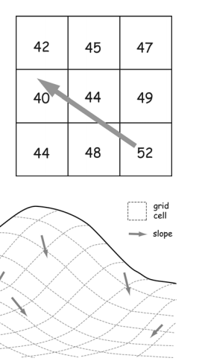
Slope Modeling
Slope calculations are complex
Slope is calculated in the steepest direction of elevation change, but this isn’t necessarily parallel to the grid cell orientation
Relative changes in neighboring cells are important
Lots of different techniques for calculating gradient and aspect.
Very important to get these right, especially aspect.

Slide 12
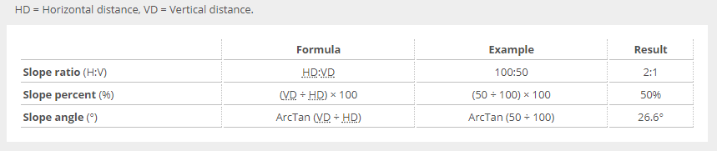
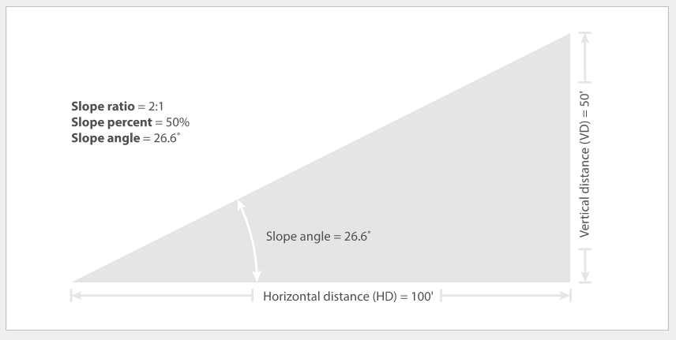
Slope Modeling
Degrees vs percent
The incline, or steepness, of a surface (‘rise over run’)
Usually expressed in percent or degrees from horizontal.

Slide 13
Slope Modeling
3 basic methods of calculating slope/aspect:
Max drop
4 and 8-neighbor
Planar

Slide 14
Max Drop Slope Method
Max Drop method
Finds the neighboring cell with largest elevation difference compared to focal point.
Uses these two cell values to determine slope at the focal point
Used a lot
Advantages:
Quick and easy
Drawbacks:
Slope derived from only 2 cells!
Aspect is in 45°increments only
Very sensitive to data errors (DEMS are
notorious for having errors & noise)
1 | 2 | 1 | 1
3 | 3 | 2 | 3
6 | 4 | 6 | 4
7 | 8 | 9 | 9

Slide 15
Four/Eight Neighbor Slope Method
Four/Eight Neighbor methods
Rooks case: calculates slope from nearest 4 cells
Bishop’s case: calculates slope from furthest 4 cells.
Queens case: calculates slope from 8 neighboring cells
Used a lot, e.g. ArcGIS uses an 8 neighbor by default
Advantages:
More accurate than max drop
Less sensitive to noise
Drawbacks:
Center cell not used
in calculation
This can create problems!
1 | 2 | 1 | 1
3 | 3 | 2 | 3
6 | 4 | 6 | 4
7 | 8 | 9 | 9
1 | 1 | 1
1 | 5 | 1
1 | 1 | 1

Slide 16
Map Algebra: Focal Functions
Focal Functions
Use surrounding cells to assign a value to center (focal) cell.
Operation performed on neighboring cells, stored in output focal cell: mean, variance, sum, median, etc.
Stats may or may not include focal cell
Can include an IDW element (weigh 4 adjacent cells higher)
Examples:
Using elevation to calculate slope.
Determining habitat diversity
based on surrounding cells
Smoothing
2 | 2 | 2 | 2
2 | 2 | 3 | 3
3 | 3 | 3 | 4
4 | 4 | 4 | 4

Slide 17
Homework for Friday
Finish Lab 8, turn in on Friday.
Complete lab 9, in preparation for Friday (don’t need to turn in).
Read these descriptions of how slope, hillshade and aspect are calculated:
Slope: http://desktop.arcgis.com/en/arcmap/10.3/tools/spatial-analyst-toolbox/how-slope-works.htm
Hillshade: http://desktop.arcgis.com/en/arcmap/10.3/tools/spatial-analyst-toolbox/how-hillshade-works.htm
Aspect: http://desktop.arcgis.com/en/arcmap/10.3/tools/spatial-analyst-toolbox/how-aspect-works.htm

Slide 18
Overview/Demo of Today’s Lab

